Slide 1
Uber Data Analysis and Visualization
-Yashwanthini aishwariya

Slide 2
Data Loading and Structuring
JSON data into Excel for initial structuring and exploration.
Data Cleaning and Preprocessing
Handled missing values, duplicates, and clean date/time formats.
Created new features such as travel_mode based on business rules:
Passenger count < 4: "Uber Go"
Passenger count > 4: "Uber XUV"
Higher-than-average fare prices for the above categories: "Uber Premium”.
Database Integration
Push the cleaned dataset to an SQL database (MySQL/PostgreSQL).

Slide 3
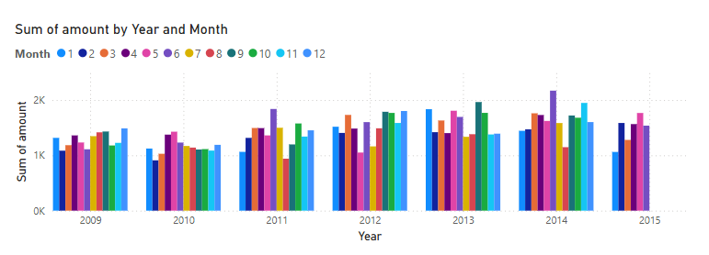
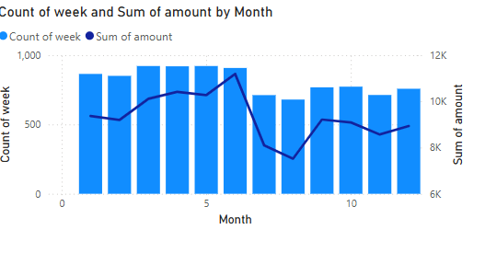
Task 1

Slide 4
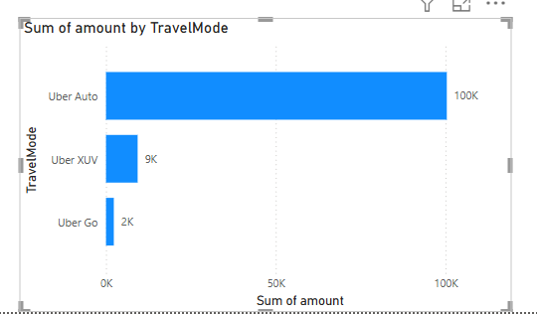
Task 2

Slide 5
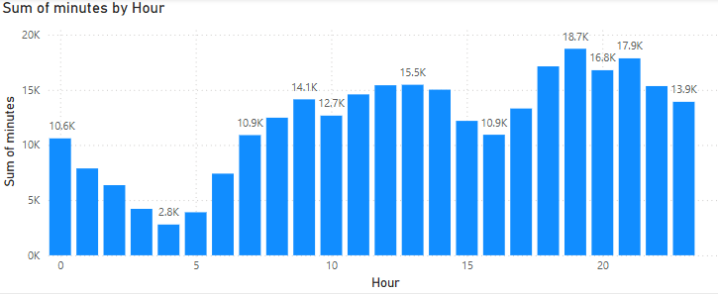
Task 3

Slide 6
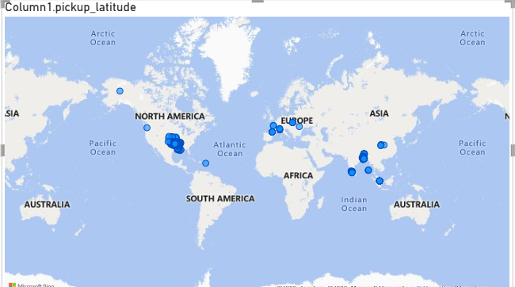
Task 4

Slide 7
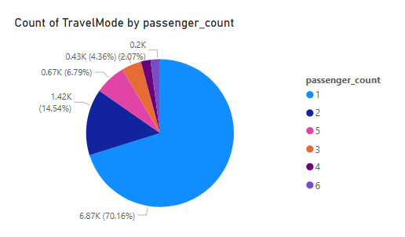
Task 5

Slide 8
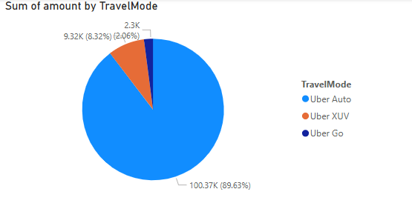
Task 6

Slide 9
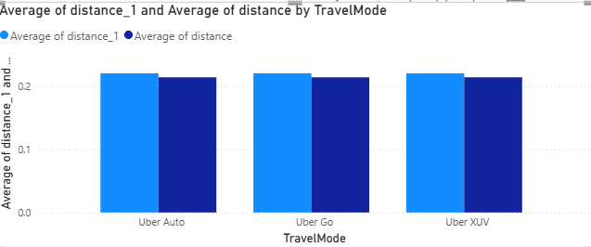
Task 7

Slide 10
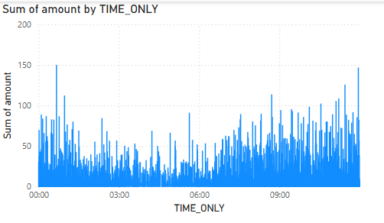
Task 8

Slide 11
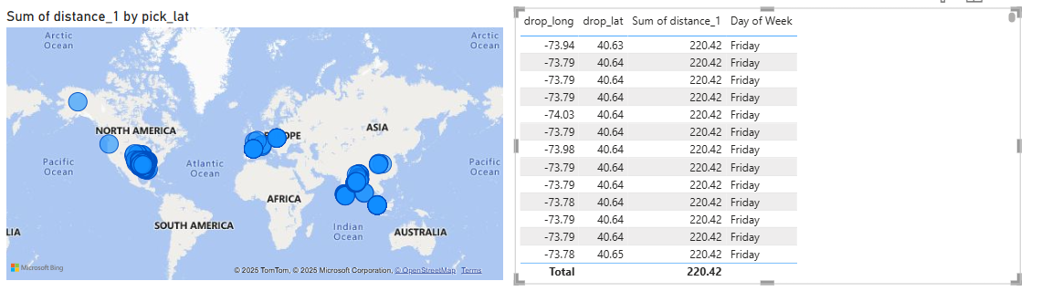
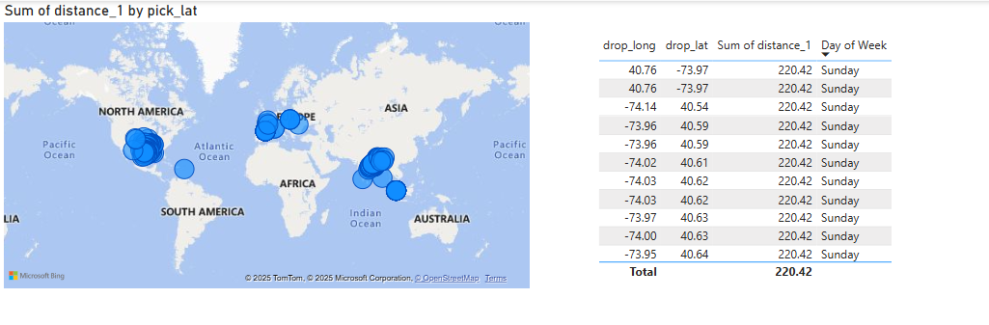
Task 9

Slide 12
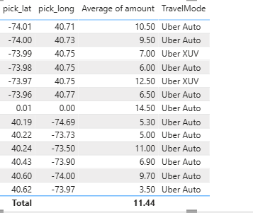
Task 10

Slide 13
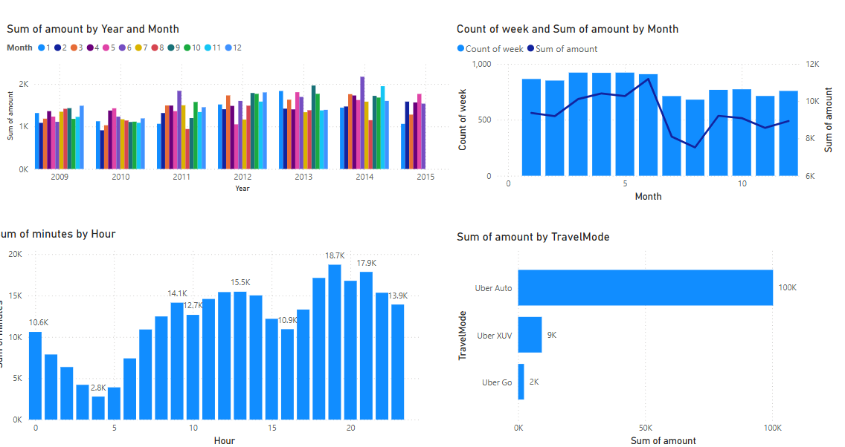
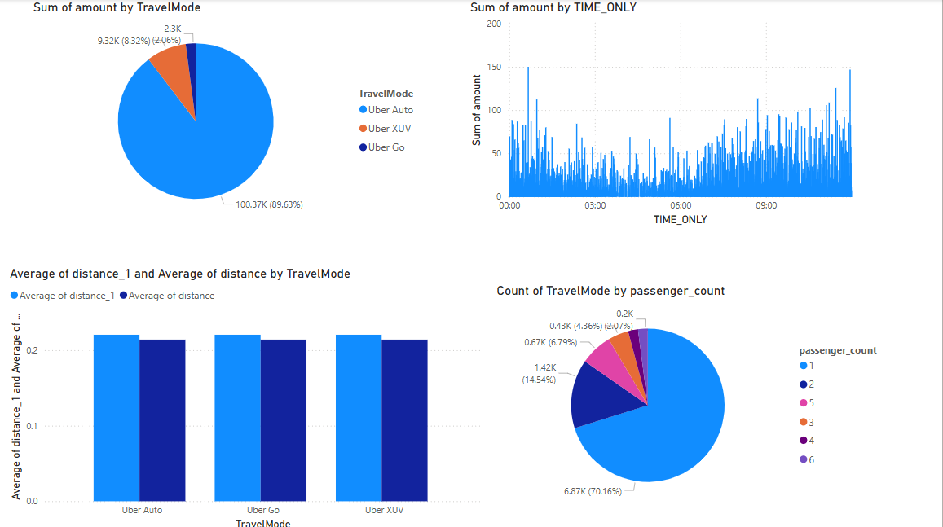
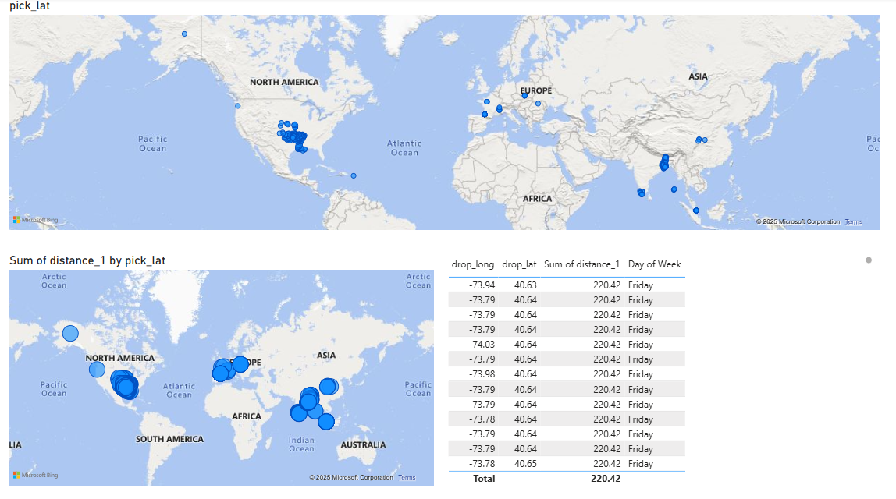
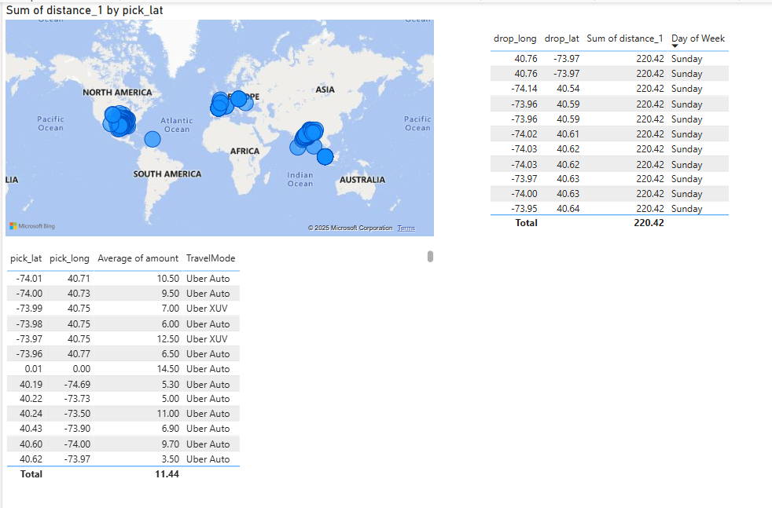
DASHBOARD

